Slide 1
Distributed System
by
Mr Alok Tiwari
(CSE Department)
KIET Group of Institutions

Slide 2
Contents
Recovery in concurrent System

Slide 3
Concurrent System Recoverys
Issue: if one of a set of cooperating processes fails and has to be rolled back to a recovery point, all processes it communicated with since the recovery point have to be rolled back.
Conclusion: In concurrent and/or distributed systems all cooperating processes have to establish recovery points

Slide 4
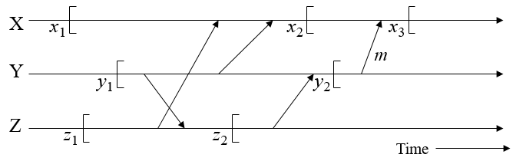
Orphan messages and the domino effect
  Case 1: failure of X after x₃ : no impact on Y or Z
  Case 2: failure of Y after sending msg. ‘m’
    Y rolled back to y₂
    ‘m’ ≡ orphan massage
    X rolled back to x₂
  Case 3: failure of Z after z₂
    Y has to roll back to y₁
    X has to roll back to x₁ Domino Effect
    Z has to roll back to z₁

Slide 5
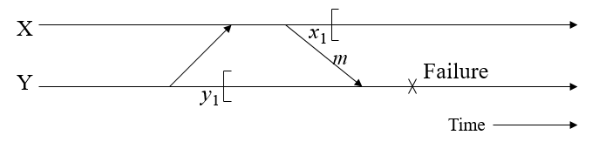
Lost messages
    Assume that x₁ and y₁ are the only recovery points for processes X and Y, respectively
    Assume Y fails after receiving message ‘m’
    Y rolled back to y₁, X rolled back to x₁
    Message ‘m’ is lost
    Note: there is no distinction between this case and the case where message ‘m’ is lost in communication channel and processes X and Y are in states x₁ and y₁, respectively

Slide 6
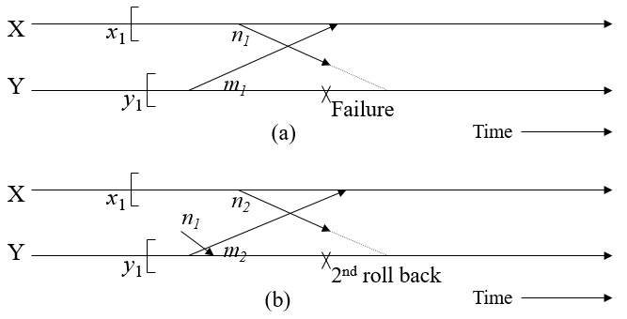
Problem of livelock

Slide 7
Problem of livelock
  A. Process Y fails before receiving message ‘n₁’ sent by X
  Y rolled back to y₁, no record of sending message ‘m₁’, causing X to roll sback to x₁
  B. When Y restarts, sends out ‘m₂’ and receives ‘n₁’ (delayed)
  When X restarts from x₁, sends out ‘n₂’ and receives ‘m₂’
  Y has to roll back again, since there is no record of ‘n₁’ being sent
  This cause X to be rolled back again, since it has received ‘m₂’ and there is no record of sending ‘m₂’ in Y
  The above sequence can repeat indefinitely

Slide 8
Thank
You

